Slide 1
Electronic monitoring proposal
Name:
Tutor:
Institution:

Slide 2
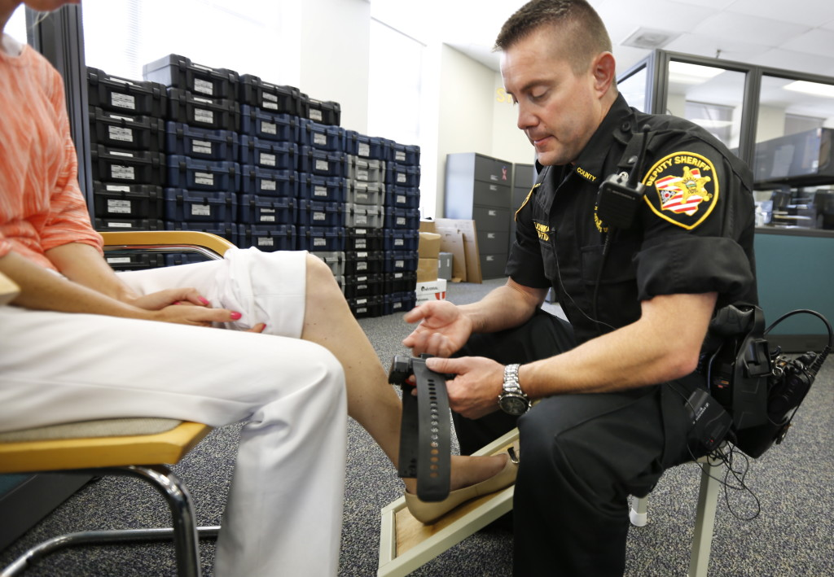
Introduction
Notes:
Throughout my duration with the Harris County Juvenile Probation Department, I have witnessed many juveniles go on their home visits for 24 hours.
No one ever return back to the court to complete their time.
At one of the Harris County facilities the home visits are one of the perks of completing the program
However when a juvenile fail to come back to the facility that causes the County to lose money trying to locate the juvenile.

Slide 3
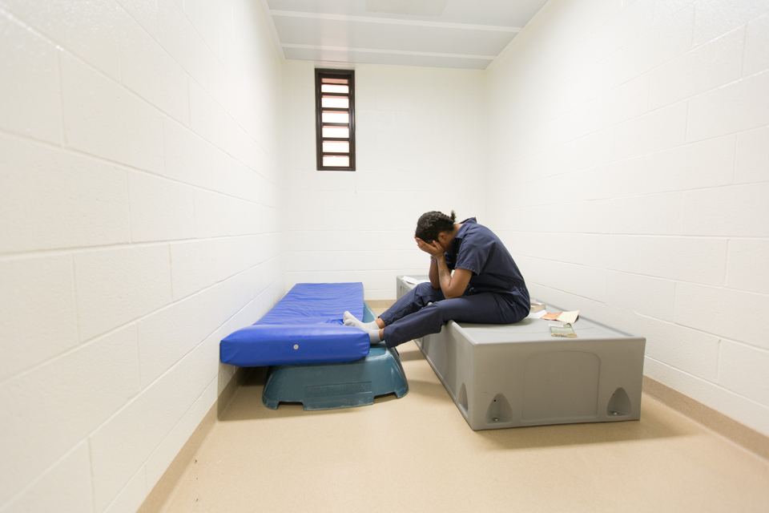
It also causes the other juveniles to not be able to go on their own home visits

Slide 4
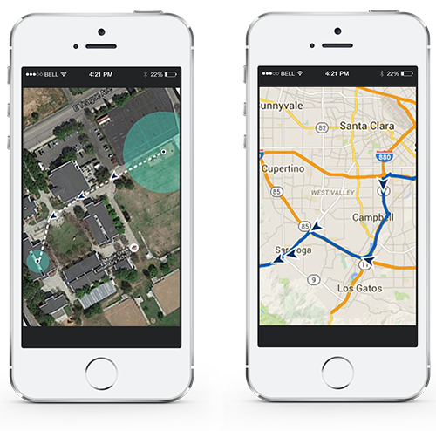
The electronic monitoring device will help law enforcement locate the juvenile.

Slide 5
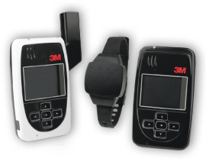
We should provide juvenile offenders an electronic monitoring device with GPS tracking
Notes:
We should provide juvenile offenders an electronic monitoring device with GPS tracking included to assure that the juvenile offenders do return to facilities when they are temporarily released.

Slide 6
RESEARCH

Slide 7
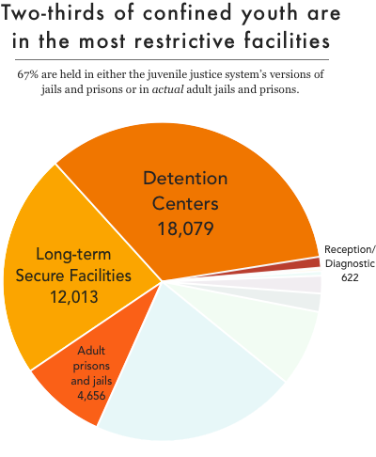
Adolescents that are and have been in the court frameworks are starting to count.
Notes:
The quantities of these adolescents are rising, and there are prime key factors that prompt this proceeding with issue.
In the present paper the Probation Officer might be a key factor to the jobs that the Probation Officer plays in their life.
It is realized that the Probation Officers have with enhancing their standard for dependability.
It has a merited notoriety for quality client benefit.

Slide 8
                DISCUSSION

Slide 9
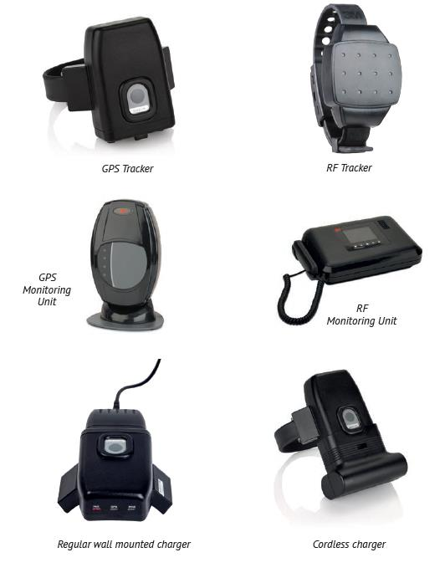
Any electronic monitoring gadget should incorporate supervision of guilty parties

Slide 10
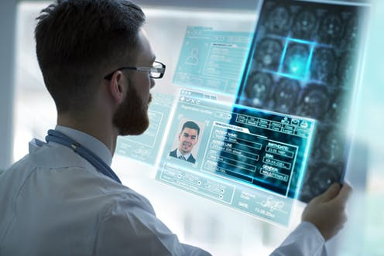
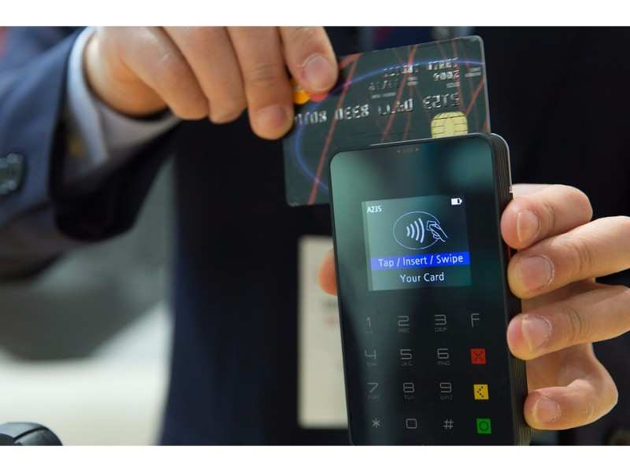
Wrongdoers must consent to pay for the an electronic checking program set by the courts.
Notes:
Guilty parties put on an electronic monitor are regularly managed by probation officers.
These officers oversee guaranteeing consistence with the court orders, exploring infringement, detailing back to the court, and guaranteeing gear fit and utilization.
In contrast to different officers of the court that expect some dimension of rehabilitative capacity, these officers are accused of guilty party the board and control rather than consideration.
In contrast to different options, were intended to be utilized related to other network-based projects, for example, house capture, curfews, network benefit, and so forth

Slide 11
Juvenile offenders put an electronic monitoring device for probation through a network program
Notes:
Guilty juvenile offenders might be put in electronic monitoring either pretrial or as an immediate sentence for probation through a network or redresses based program.
Electronic checking has been utilized with an assortment of guilty parties including sex wrongdoers, rough guilty parties, aggressive behavior at home wrongdoers, pack individuals, and medication guilty parties.
While every one of these projects contrasts by the motivation behind their organization, the supervision obligation continues as before.
The guilty parties get arbitrary phone calls for the duration of the day when they should be home.

Slide 12
Conclusion
In the first place, electronic observing is a less expensive option in contrast to customary imprisonment.
According to the Texas Juvenile Justice Department, it costs $437.11 a day to detain a juvenile.
Further gauges of the extended utilization of GPS innovation propose a yearly decrease in wrongdoing would establish $481.
1 billion in cost reserve funds. Further, by lessening the length of jail sentences from 85 to 50 percent of time served, the cost– advantage proportion to nationals would be a gain of $12.70 for each dollar consumed on GPS innovation.

Slide 13
References
Camp, C. G., & Camp, G. M. (1993). The corrections yearbook: Probation and parole. South Salem, NY: Criminal Justice Institute.

